Slide 1
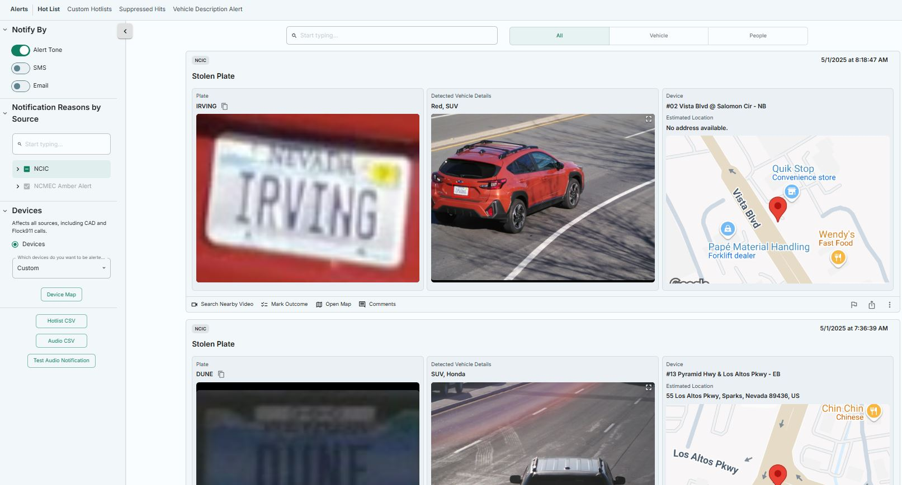
How to use the Alerts page
Key Points
Notify By – This is where you can set how you receive alerts. You can receive them three ways. When Alert Tone is selected, you will receive an audible sound when a NCIC hit is received.
Notification Reasons by Source- This will allow you to toggle on and off the available NCIC hits.
Devices – This will be the camera group that you set for notifications both on the desktop and the app.
**Important Note**
If in the device category, you have all available cameras selected, you will receive hits in multiple states we share cameras with, and you will be flooded with useless information. Instead, create a camera group for specific areas, i.e. Eugene, or Lane County as a whole.
Notes:
Demonstrate this feature.

Slide 2
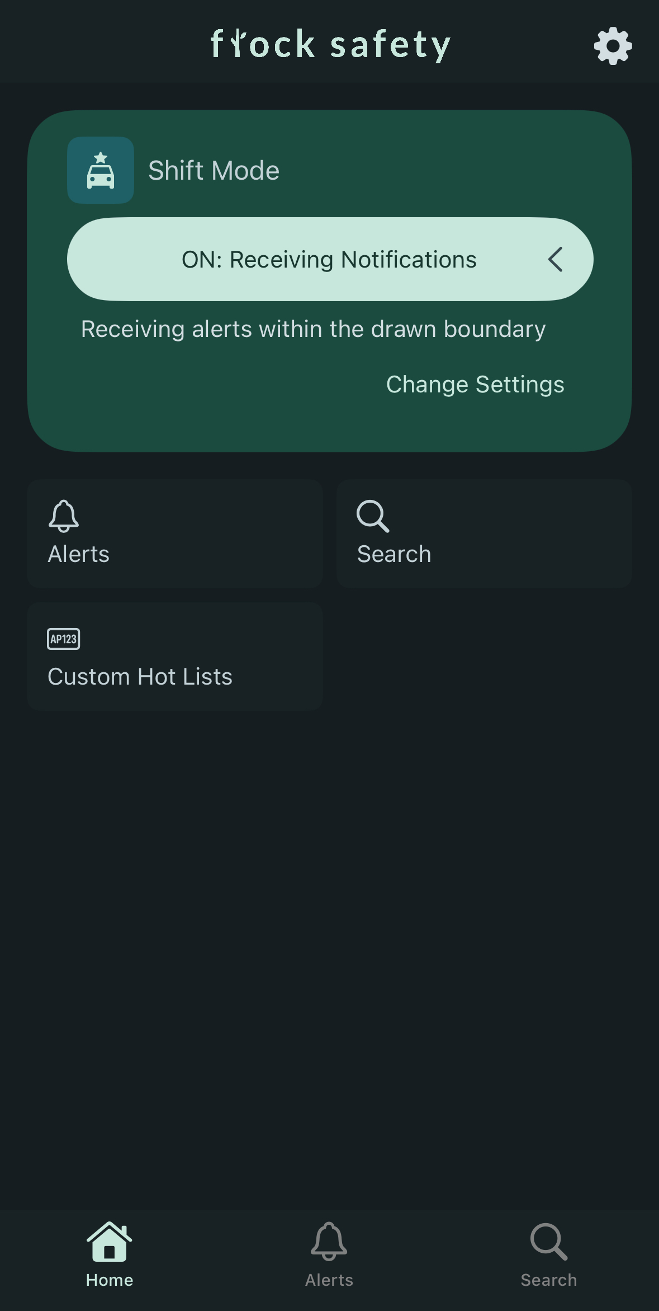
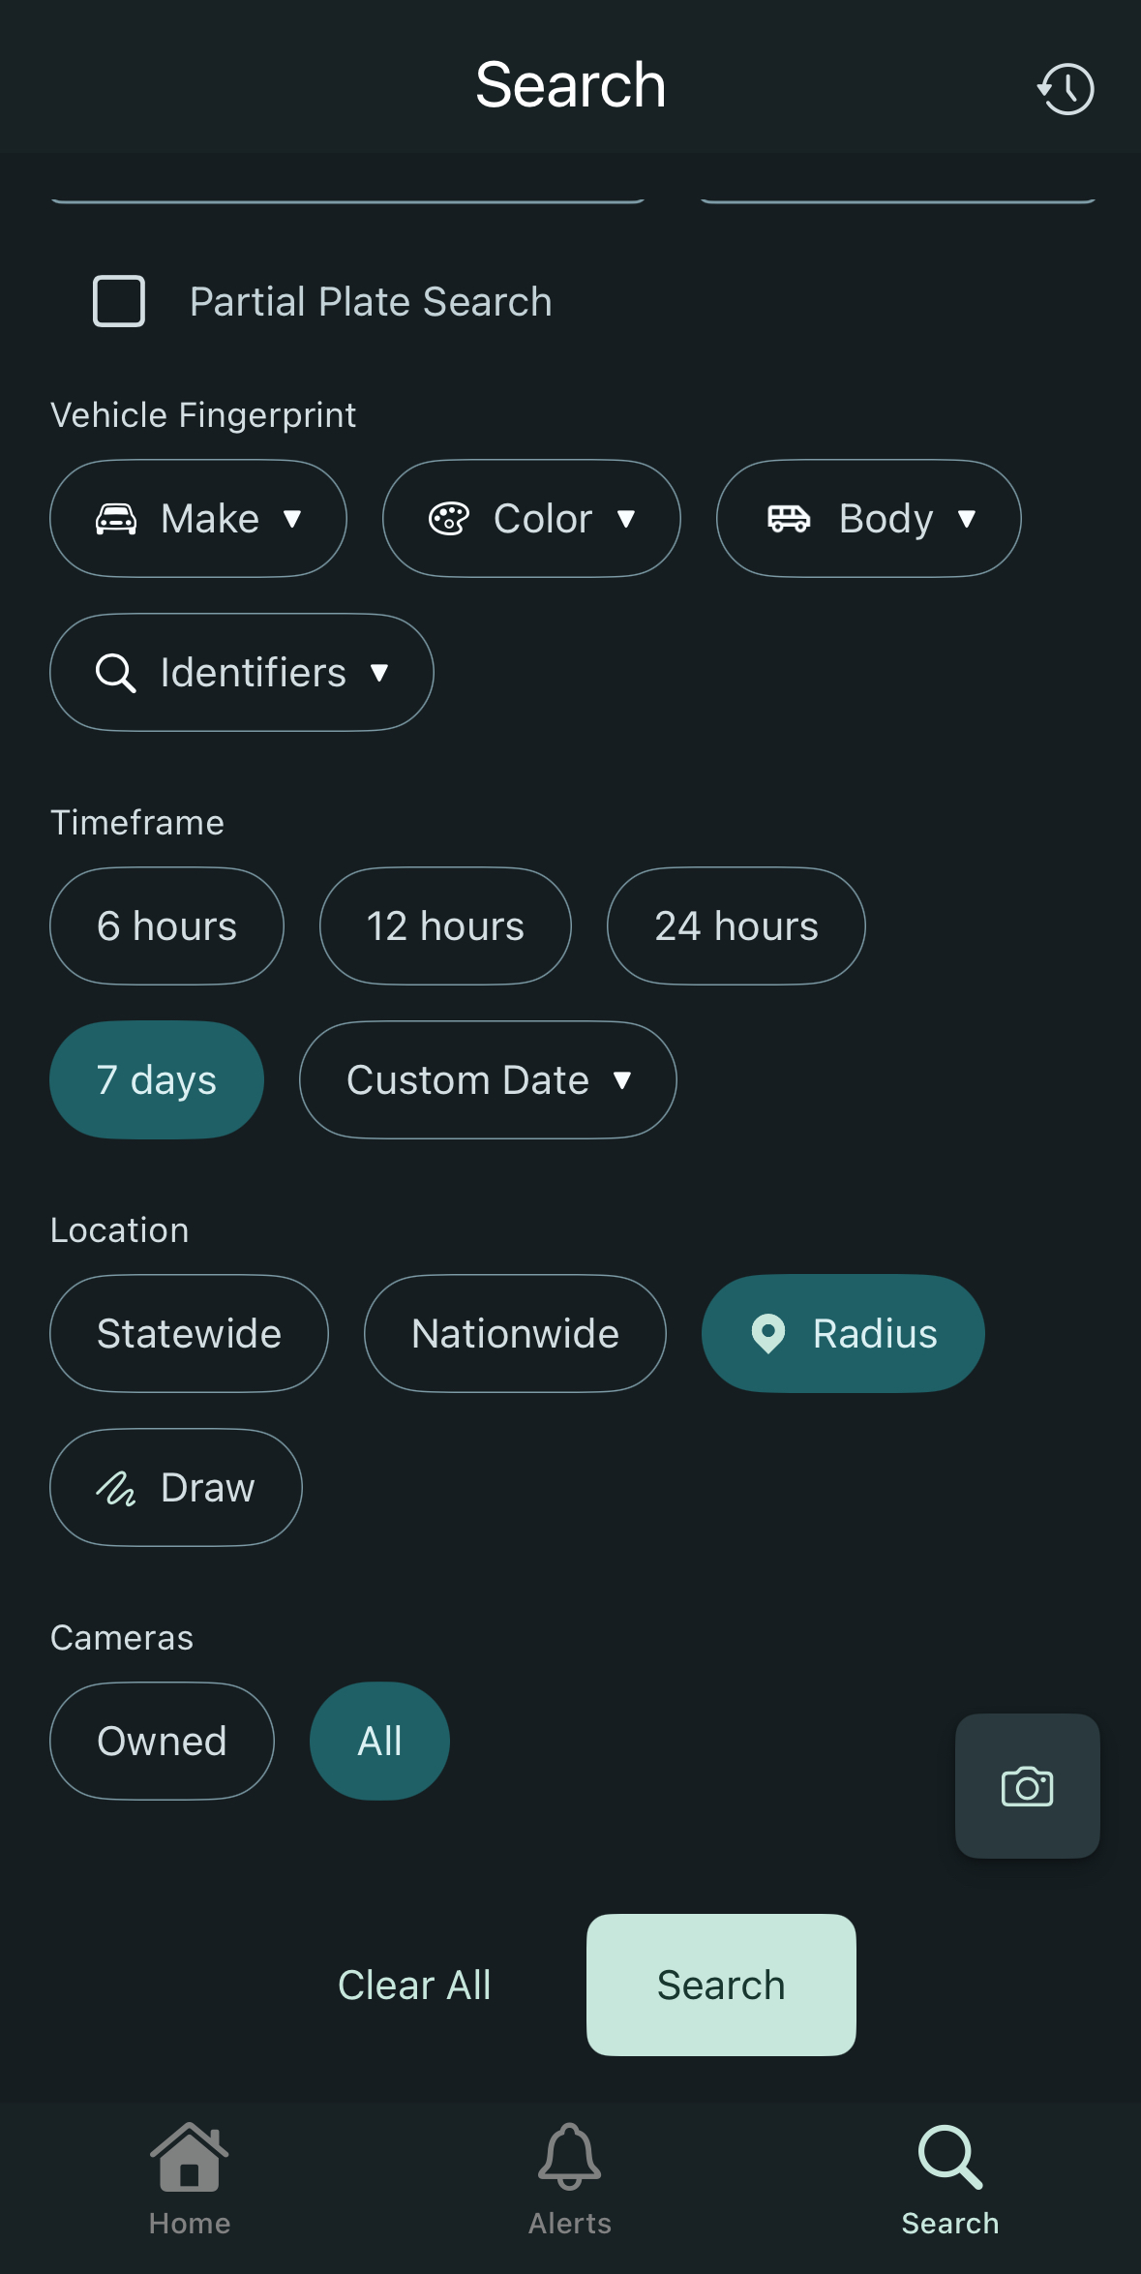
How to use Flock - Mobile
Key Points
Shift Mode – Quick toggle on and off for alerts
Alerts – See the last couple days work of alerts. Alerts will mirror the area, and options you select from the desktop.
Search – Standard search options
**Important Note**
Location/Cameras. When selecting statewide, radius, etc., make sure to switch the cameras from “owned” to “all”. This will capture your geographical area better.
Notes:
Demonstrate this feature.

Slide 3
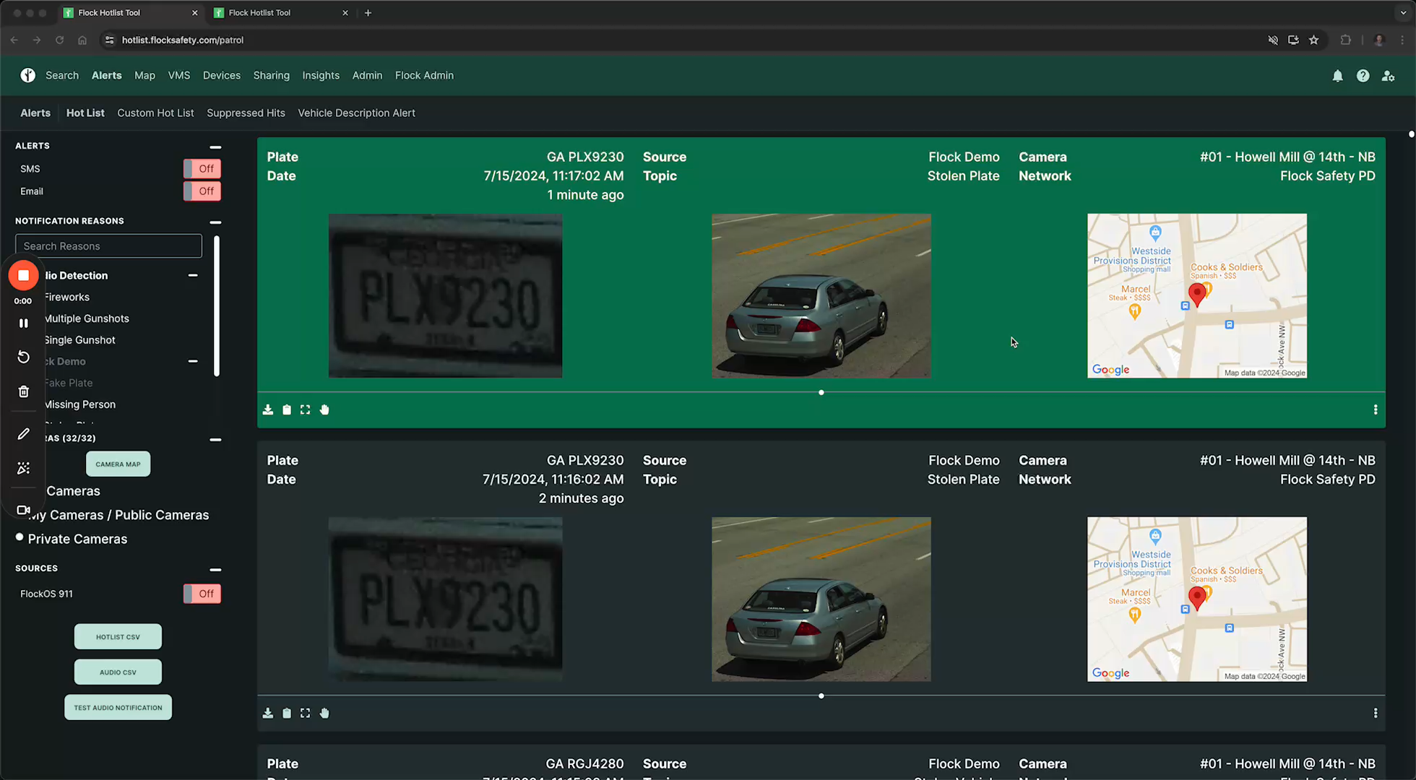
Flock Custom Hot List Video
Notes:
Demonstrate this feature.

Slide 4
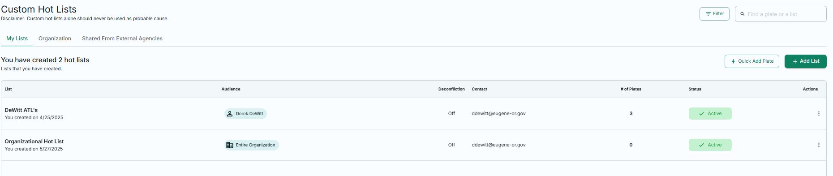
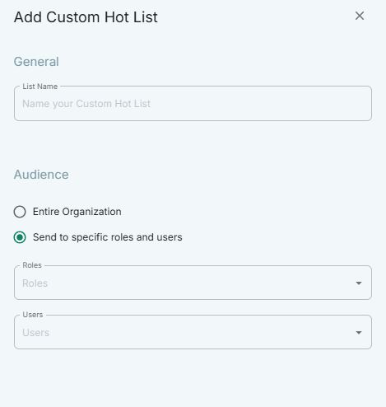
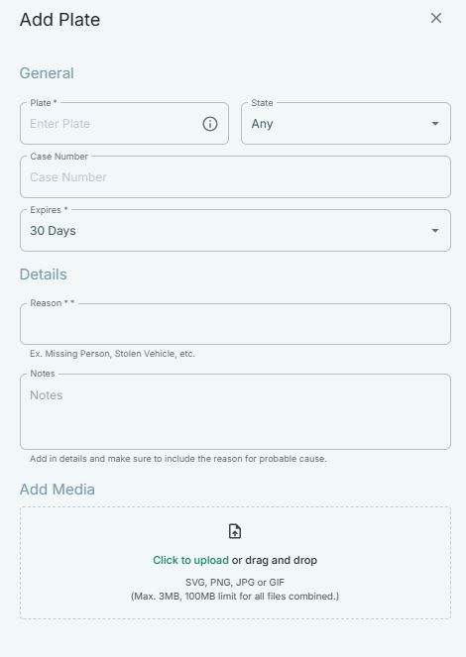
Custom Hot List Demo

Slide 5
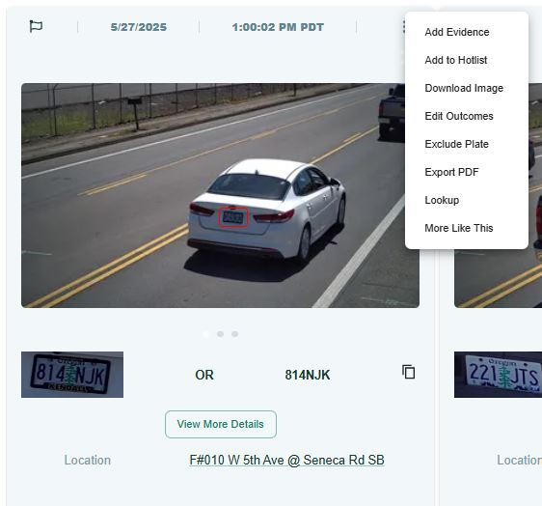
Evidence.com
The link to upload information found on Flock to Evidence.com is disabled. Currently, you will uploaded flock evidence, the same way you upload evidence currently.
Option # 1. If it’s a solo image, click on export PDF. Download the PDF and upload as a photo/PDF.
Notes:
Demonstrate this feature.

Slide 6
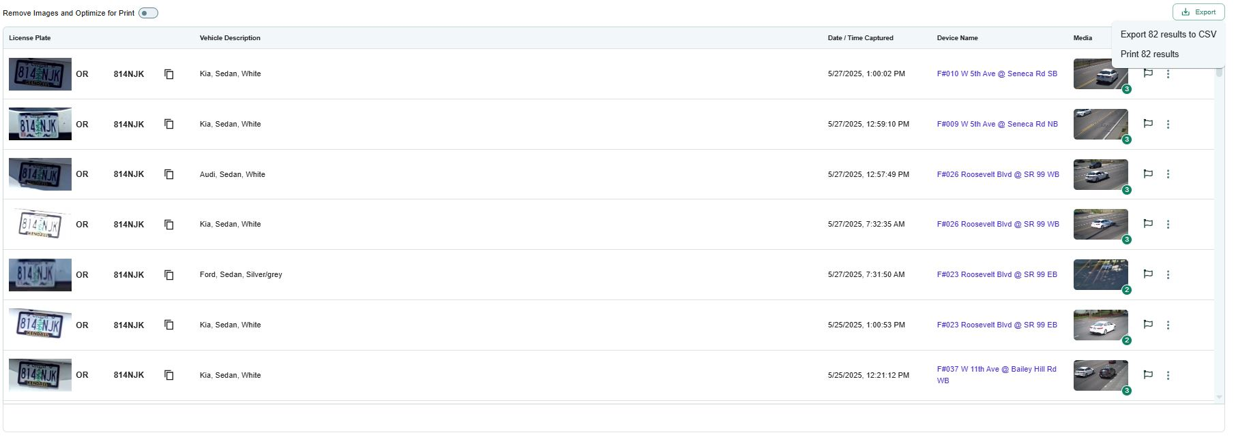
Evidence.com
Option # 2
Notes:
Highlight the fact that this same plate provided different Makes of vehicles as well as color. Explain how searching sedan and variations of colors would be a better search then one color alone.

Slide 7
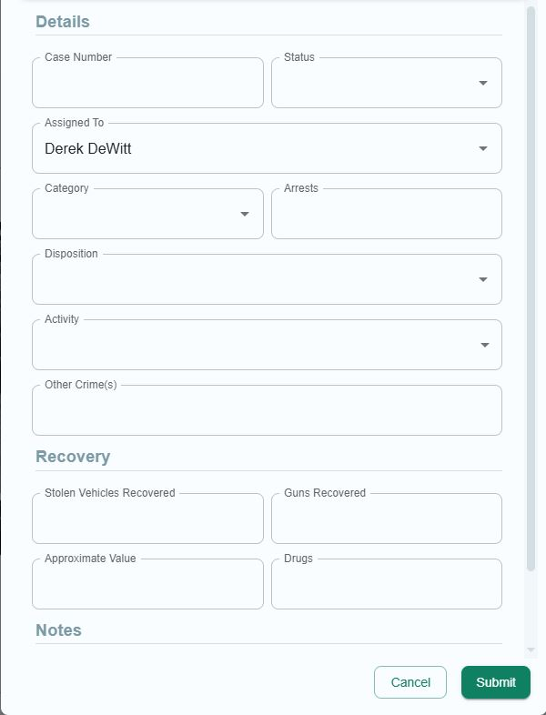
How to log an outcome
**Important Note**
This is what we are using in partial, to track how well the system is working and the positive impact on our investigations and for the community. If you take nothing else from this training, it would be to ensure you log an outcome in this space to show how well the system is working and being used to identifying suspects.
Notes:
Demonstrate this feature.

Slide 8
Policy

Slide 9

Flock Safety
Questions??

